Slide 1
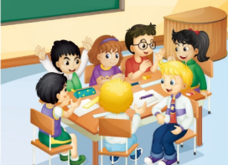
U5 General Revision 2
人教精通版六年级下册
WWW.PPT818.COM

Slide 2
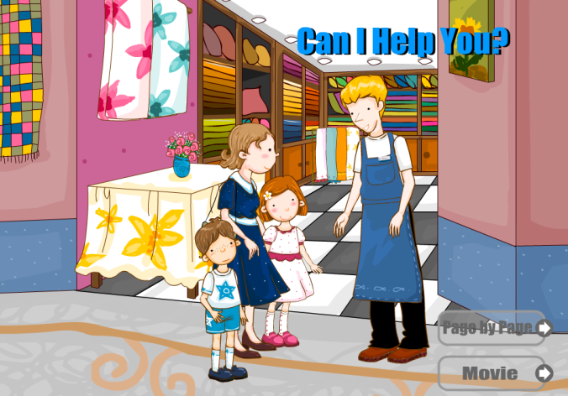
>>Warm-up
情景动画

Slide 3
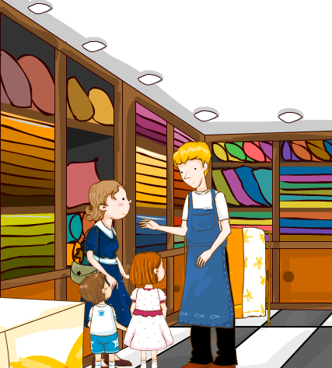
>>Lead-in
Where are they?
They’re in a shop.
What does the mother want to do?
She wants to buy a tablecloth.

Slide 4
>>Lead-in
Discuss
Do you like shopping?
What do you want to buy in a shop?

Slide 5
>>Presentation
Listen, read and talk
Saleswoman: Good morning! Can I help you?
Dad: Yes. We want a toy car.
Saleswoman: Which one would you like?
Nick: I’d like that blue one.
Saleswoman: OK. Here you are.
Dad: How much is it?
Saleswoman: It’s sixty-nine yuan.
Dad: We’ll take it. Thank you.

Slide 6
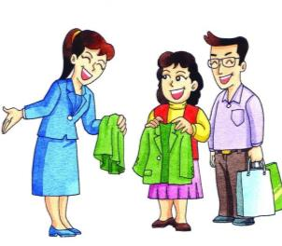
>>Practice
Can I help you?
Yes. I want…
I’d like…
Which one would you like?

Slide 7
>>Presentation
Listen, read and talk
Saleswoman: What can I do for you?
Kate: I want a pair of shoes, please.
Saleswoman: How about this green pair?
Kate : Sorry, I like that purple pair.
Saleswoman: OK. Here you are.

Slide 8
>>Practice
What can I do for you?
Yes. I want…
Sorry, I like…
How about this one?

Slide 9
>>Presentation
Listen, read and talk
Kate: Can I try them on?
Saleswoman: Certainly!
Kate: Oh, they’re good.
Mum: How much are they?
Saleswoman: They’re ninety-eight yuan.
Mum: OK, we’ll take them. Thank you! Bye-bye!
Saleswoman: Bye!

Slide 10
>>Practice
Can I try it/them on?
Certainly!
It’s/They’re…
How much is it / are they?

Slide 11
>>Practice
purple
blue
sixty-nine
ninety-eight
Nick wants a _____ toy car.
It’s __________ yuan.
blue
sixty-nine
2. Kate wants a pair of _______ shoes.
They’re ___________ yuan.
purple
ninety-eight

Slide 12
>>Practice
Group Work
Good morning! Can I help you?
Yes, I want a…

Slide 13
>>Summary
购物时的常用句型：
Can I help you?/What can I do for you?
I want/I’d like…
Can I try…on?
Here you are.
How much…?
It’s/They’re…

Slide 14
>>Homework
1.观看课文动画，按照正确的语音、语调朗读课文。
2.熟练朗读本文的对话，并能表演出来。
close

