Slide 1
Unit 9 Who is this cute baby?
WWW.PPT818.COM

Slide 2
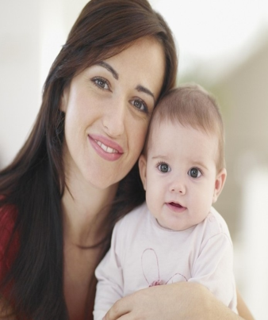
review words
father 爸爸
mother妈妈
Who？

Slide 3
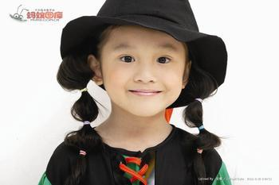
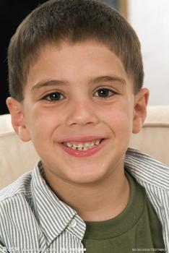
review the words
sister 姐妹
brother兄弟
Who？

Slide 4
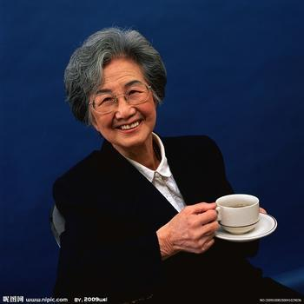
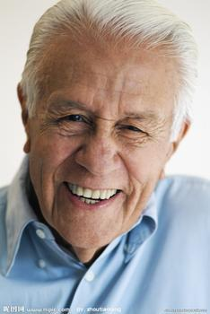
grandpa(grandfather）
爷爷，外公
grandma(grandmother）奶奶，外婆
Who？

Slide 5
listen a song: finger family

Slide 6
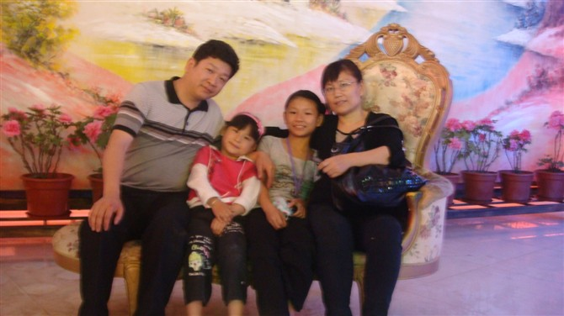
learn new words
photo相片
a photo of Song Jiarui.

Slide 7
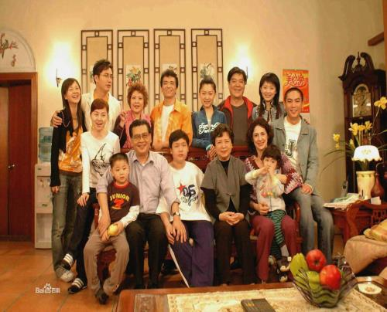
there 那里
there is … 有…

Slide 8
father tall
tall（高的）

Slide 9
mother short
short
（ 矮的）

Slide 10
sister lovely
lovely
(可爱的）

Slide 11
brother heavy
heavy
（重的）

Slide 12
grandfather old
old (老的）

Slide 13
grandmother happy
happy（高兴的）

Slide 14
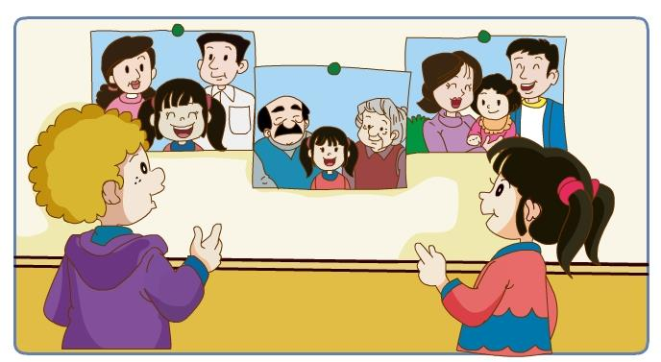
My family
Mother short ,
father tall,
brother heavy,
sister lovely,
grandfather old,
grandmother happy.
That is my family.

Slide 15
review the words
photo 相片 there is 有
tall 高的 short 矮的
lovely 可爱的 heavy 重的
old 老的 happy高兴的
baby 宝宝

Slide 16
review the words
thin 苗条的
fat 胖的
cute 可爱的
uncle 叔叔
aunt 阿姨

Slide 17
family

Slide 18
family
f--father a--and
m--mother i--I l --love y--you
sentence:father and mother,Ilove you

Slide 19
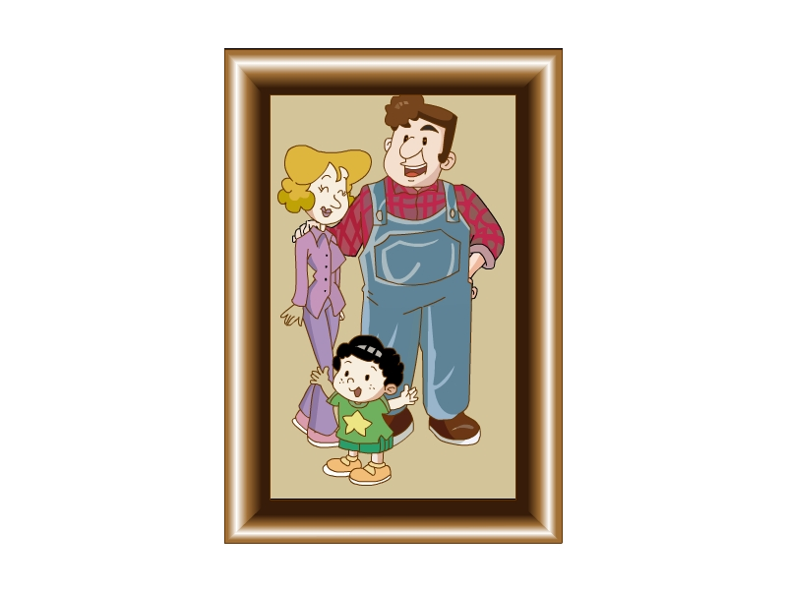
photo
A photo of …’s family.

Slide 20
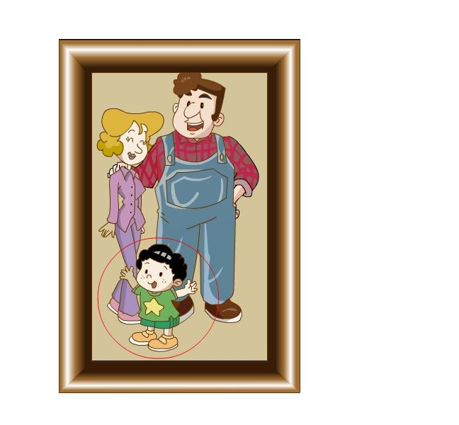
a cute baby
baby
A cute baby
Who is the cute baby?
It’s Ben’s cousin.

Slide 21
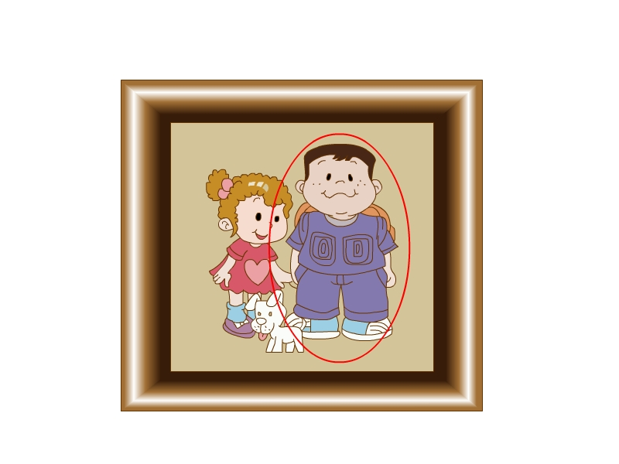
lovely
heavy
A lovely girl
A heavy boy
Who is this ?
lovely girl
heavy boy
It’s Ben.
It’s Ben’s sister.

Slide 22
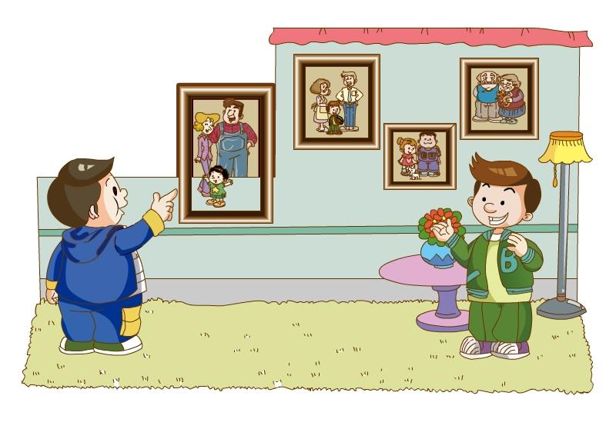
short
tall
Who is the tall man?
Who is the short woman?
She is Ben’s mother.
He is Ben’s father.

Slide 23
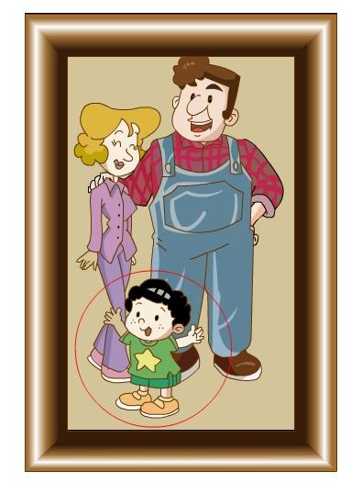
There is a strong man in the photo.
Who is he?
He is Ben’s uncle.

Slide 24
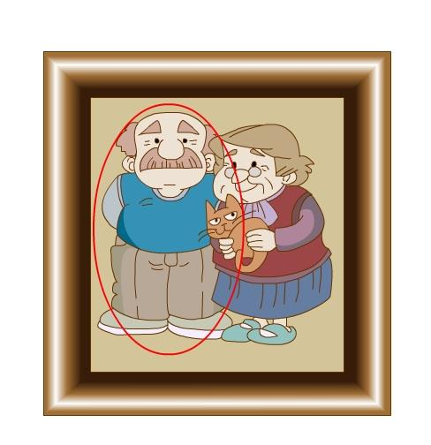
Ben’s
grandfather
grandmother
old
happy
There is a/an … in the picture.
Who is he/she?
He/She is ….
Ben’s grandmother.
Ben’s grandfather.

Slide 25
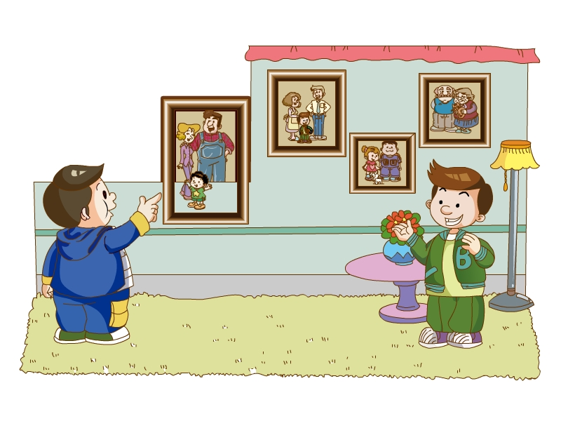
Listen and say

Slide 26
Watch the video and answer the following questions:
1. Is this a photo of Ben’s family?
Yes, it is.
2.Who is the strong man?
He is Ben’s uncle.

Slide 27
Watch the video and answer the following questions:
3. Is Ben’s aunt heavy?
No, it isn’t.
4. Who is the cute baby?
He is Ben’s cousin.

Slide 28
听录音，判断对错。
( ) 1This is a photo ofJiamin’s family.
( ) 2 The strong man is Ben’s uncle.
( ) 3 Ben’ s aunt is short and thin.
( ) 4 The cute baby isn’t Ben’s brother.
( ) 5 Ben’s cousin is cute.
F
T
F
T
T

Slide 29
Thank you for your listening!

