Slide 1
Module 8
Unit 1
I always like birthday parties
WWW.PPT818.COM

Slide 2
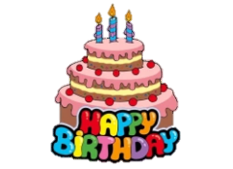
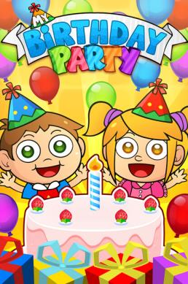
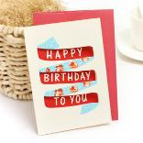
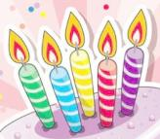
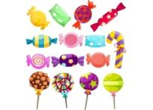
birthday cake
present
card
candles
candy
Happy Birthday song

Slide 3
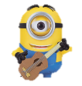
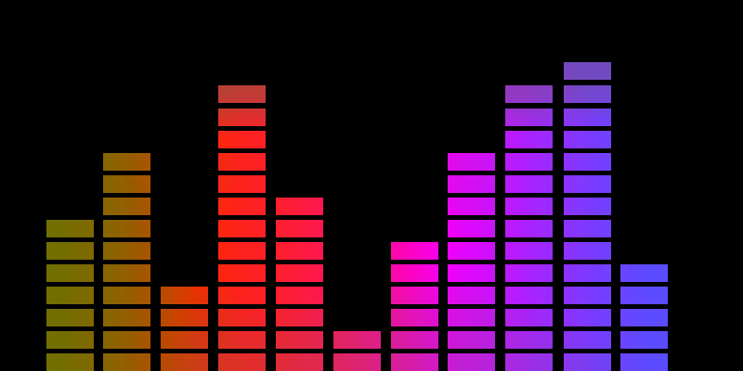
“ Happy Birthday Song ”

Slide 4
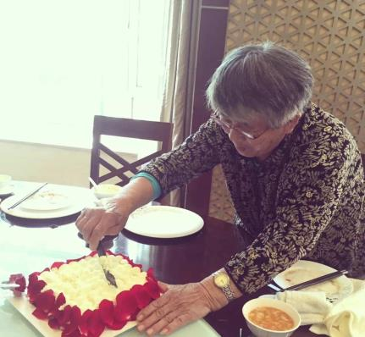
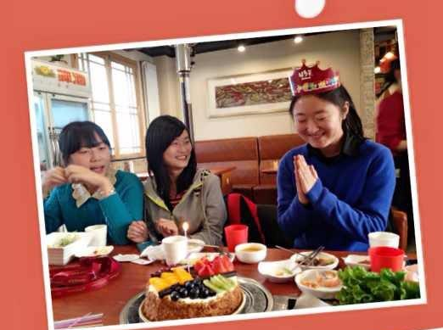
- Would you like to go to birthday parties?
- I’d love to.
my grandmother
my roommate

Slide 5
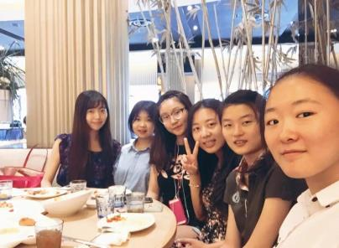
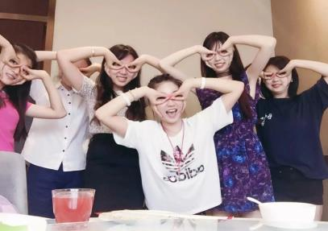
Would you like to know something about my birthday parties?
my birthday party

Slide 6
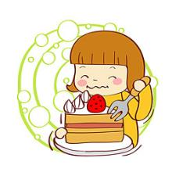
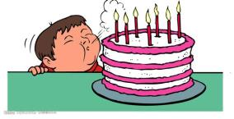
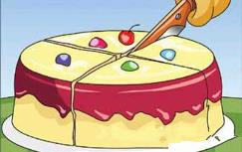
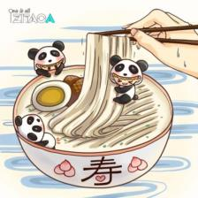
What can you do on a birthday party?
Make a order for these things
blow the candles
cut the cake
eat birthday cake
get present or card
eat noodles
sing Happy Birthday song

Slide 7
Work in pairs
— What would you like to do at your birthday party?
— I’d like to …
eat cakes
sing
get cards
get presents
cut the cakes
eat noodles
hold a party
. . .

Slide 8
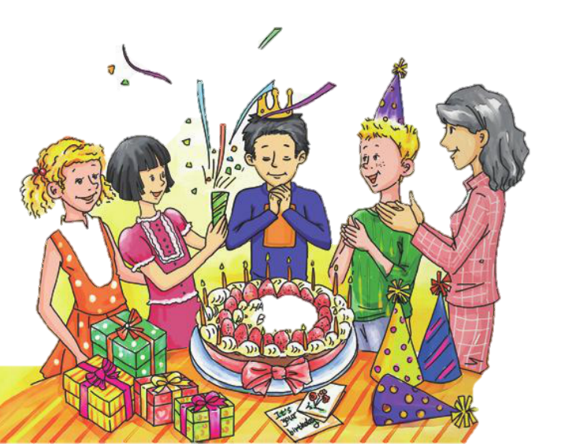
1. Look at the picture and talk about it.
birthday cake
presents
hats
cards

Slide 9
2. Listen and number the words as you hear them.
birthday
card
party
present
1
3
4
2

Slide 10
3. Listen and read .
How many people can you find in this dialogue ?
Four. (Daming, Betty, Tony, Lingling)
2. What are they talking about?
Birthday parties.
3. Who is going to have a birthday party?
Daming.

Slide 11
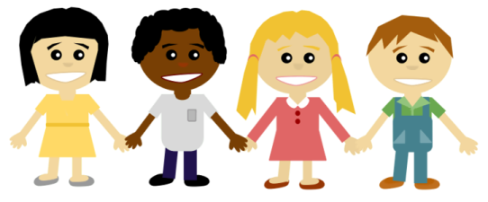
3. Listen and read .
Lingling Tony Betty Daming
Role play

Slide 12
3.Underline the answer on the book.
1. When and where will Daming hold the birthday party?
2. What does Daming usually do at a birthday parties?
3. Does Daming sing the birthday song in English or Chinese?
4. What would Daming like for his birthday?
Saturday, at his house
Eat noodles and birthday cakes.
In Chinese and English.
It’s a secret.

Slide 13
On my birthday :
 | 2011 | 2012 | 2013 | 2014 | 2015
get presents
eat cake
sing the song
get cards
play games
√ √ √ √ √
always
X √ √ √ √
usually
X X √ √ √
often
X X X √ √
sometimes
X X X X X
never
I always get presents on my birthday.
I usually eat birthday cakes on my birthday.
I often sing Happy Birthday Song on my birthday.
I sometimes get birthday cards on my birthday.
I never play games on my birthday.

Slide 14
Circle these words on your textbook.
always x3
usually x3
sometimes x2
never x1

Slide 15
Now check the true sentences.
T
F
F
T
F
1. It’s Daming’s birthday party on Saturday.
2. Tony never likes birthday parties.
3. Daming’s mother sometimes makes a birthday cake.
4. Daming’s family always sings Happy birthday.
5. Daming never has birthday presents.

Slide 16
- What do you always/usually/sometimes/never…
do on your birthday?
- I sometimes eat cakes on my birthday.
I | always usually often sometimes never | eat cakes sing get cards get presents cut the cakes eat noodles hold a party … | on my birthday

Slide 17
Work in pairs
—What do you often/usually/always/… do on your birthday?
—I often/ usually/ always/… __on my birthday.
—What do you often/usually/always/… do on Teachers’ Day?
— I often/ usually/ always/…__ on Teachers’ Day.

Slide 18
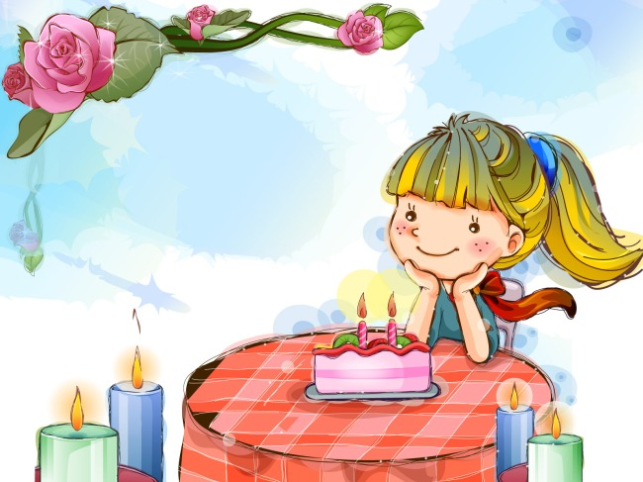
What birthday present would you like to send to your parents?

Slide 19
5.Complete the sentences with the words
from the box.
always never sometimes usually
1. Tony _______ likes birthday parties.
2. We _______ eat noodles at the
birthday dinner.
always
usually
3. Daming’s mother __________ makes a birthday cake.
4. Lingling ___________ gives birthday cards.
never
sometimes

Slide 20
4. Underline the correct words.
At my birthday party, my mother usually buys a (1) special / secret birthday cake. My friends sing Happy birthday, and then I (2) cut / make it. My friends usually give me cards and ( 3) cakes / presents. I always love birthday parties!

Slide 21
Homework
Survey: customs of other countries on birthday
(no less than 1 country)
2. Interview 3 classmates
“What do you usually do on your birthday?”
Write down their names and answers

