Slide 1
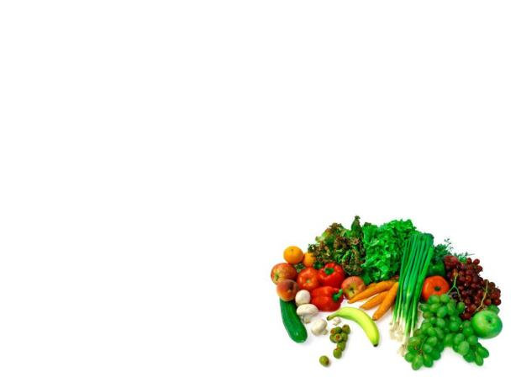
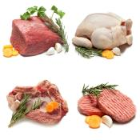
Unit 9
It smells delicious
WWW.PPT818.COM

Slide 2
Sing a song
“Come on baby!”

Slide 3
I’m hungry now.

Slide 4
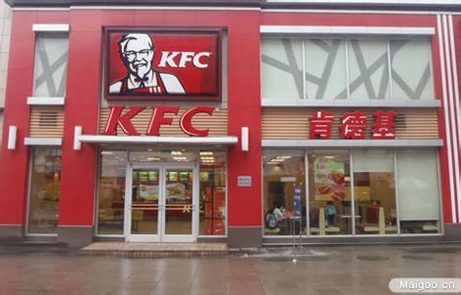
I think I’ll go to KFC first.

Slide 5
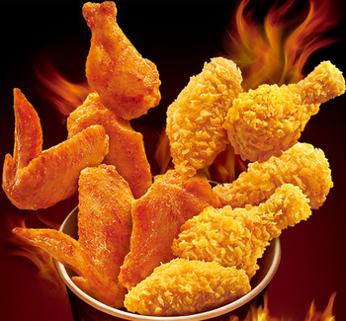
Do you like them?

Slide 6
They look delicious, but very hot.

Slide 7
I don’t like hot food.

Slide 8
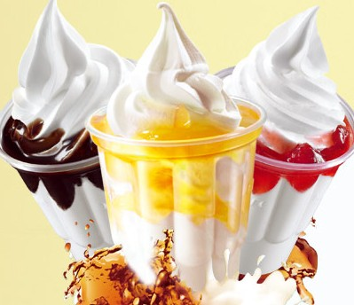
They are quite sweet.

Slide 9
I don’t like sweet food, too.

Slide 10
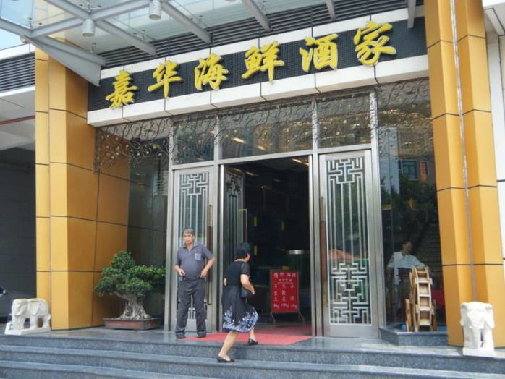
Maybe we can go to the Jiahua Restaurant.

Slide 11
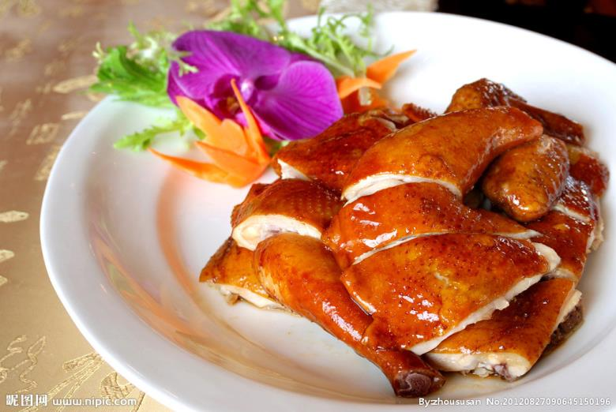
What do you think of the chicken?

Slide 12
It smells delicious and it is salty.

Slide 13
Let’s try the chicken.
It tastes very good.

Slide 14
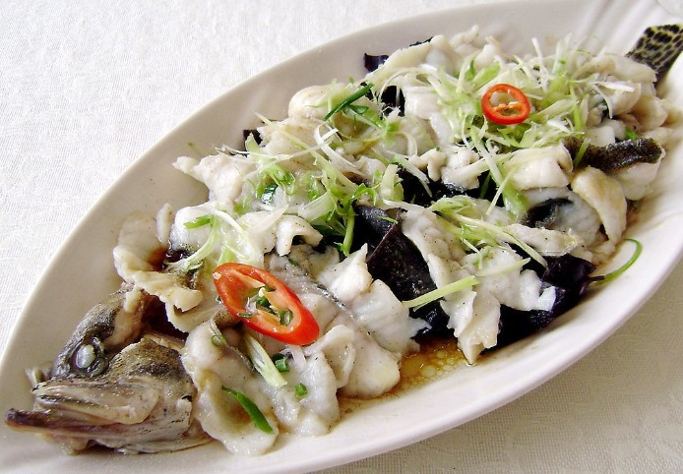
What do you think of the fish?

Slide 15
It is delicious and healthy.

Slide 16
I hope you’ll enjoy it.

Slide 17
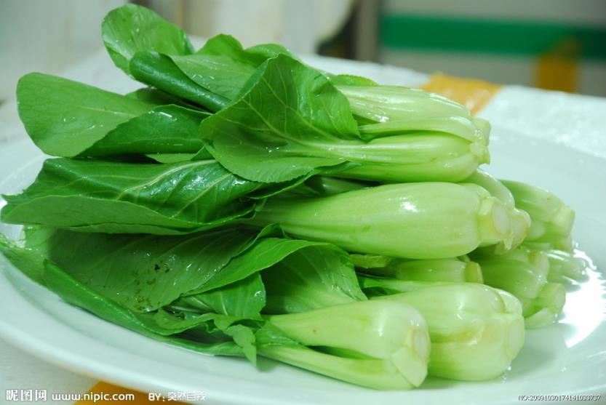
What do you think of the vegetables?

Slide 18
They are salty. And fresh too.

Slide 19
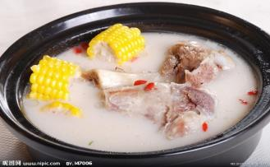
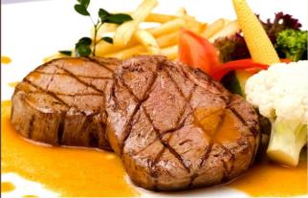
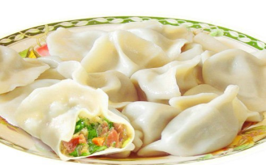
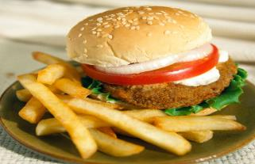
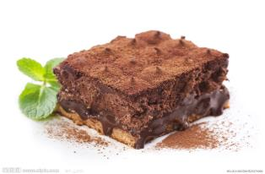
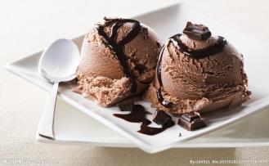
What do you think of the …?

Slide 20
What kinds of foods are they?

Slide 21
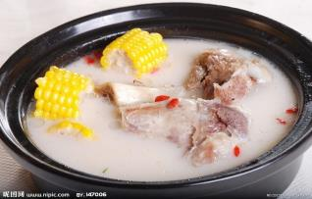
Salty food:

Slide 22
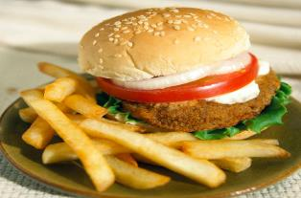
Hot food:

Slide 23
Sweet food:

Slide 24
I can’t wait! I want to taste them now.

Slide 25
Game:
come on hungry first
delicious quite sweet
smell salty taste
healthy fresh wait

Slide 26
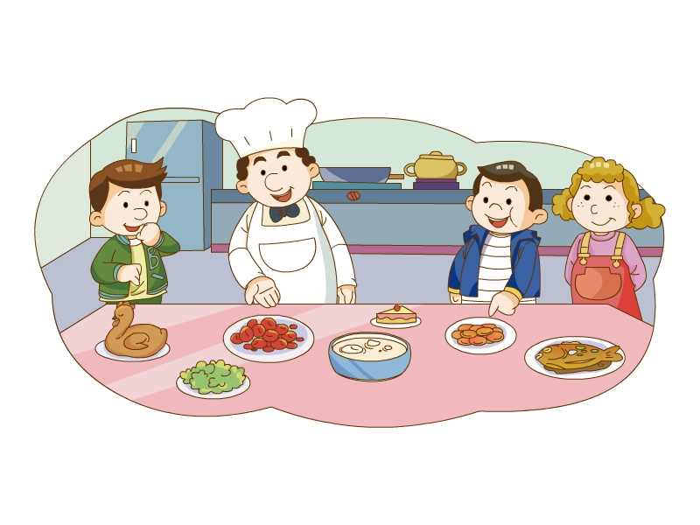

Slide 27
Watch and write “T” or “F”：
( )1.It’s time to have dinner.
( )2.Ben will try the chicken first.
( )3.Jiamin likes hot food.
( )4.The sandwiches are very salty.
( )5.The fish is good and healthy.
( )6.Jiamin feels very hungry now.
F
T
F
T
T
T

Slide 28
Read and act out

Slide 29
Follow the tips and finish the passage:
It’s time to h lunch. Ben will t the chicken f . It’s d but very h . Jiamin d like hot food. He l . sweet food. The sandwiches are s . And the dumplings are q sweet. The fish is good and h too. Everything l great.
ave
ry
irst
elicious
ot
oesn’t
ikes
alty
uite
ealthy
ooks

Slide 30
Make a survey:
name | favourite food | reason
A:What’s your favourite food?
B: My favourite food is…
A: Why do you like it?
B: Because it’s …

