Slide 1
初中英语外研版版八年级下
Module3 Journey to space
Unit1 Has it arrived yet?
WWW.PPT818.COM

Slide 2
Warm-up
1
Presentation
2
Language Points
3

Slide 3
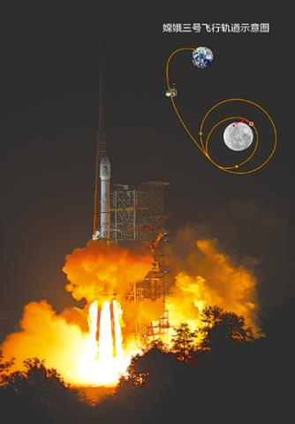
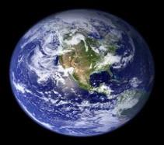
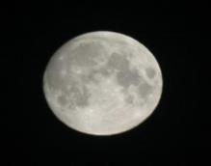
Presentation
New words
earth n.地球
moon n.
月亮；月球

Slide 4
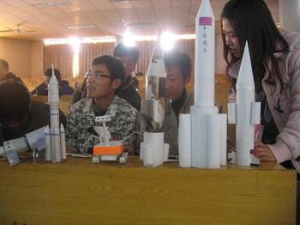
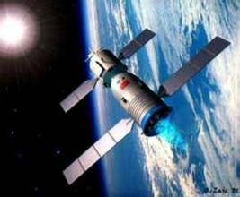
model n.模型
spaceship n.
航天器

Slide 5
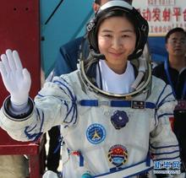
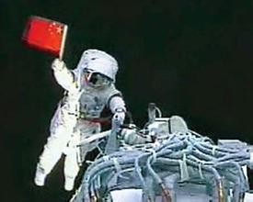
astronaut n.宇航员

Slide 6
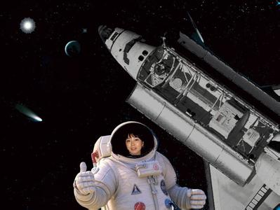
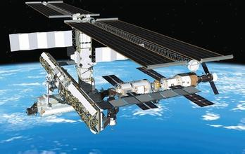
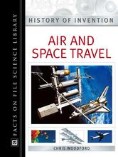
space travel
航天旅行

Slide 7
Listening and vocabulary
1. Listen and number the words as you hear them.
earth land message
moon news planet
reach scientist
1
2
5
7
3
8
4
6

Slide 8
2. Listen again and complete the notes.
● news about the trip to (1) _________
● journey of (2) _________ months
● has not sent back any (3) _________ yet
● hope to find (4) _______ on Mars
Mars
eight
messages
life

Slide 9
Listen and read
Pay attention to the following sentences.

Slide 10
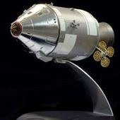
I’ve just made a model spaceship for our school project.

Slide 11
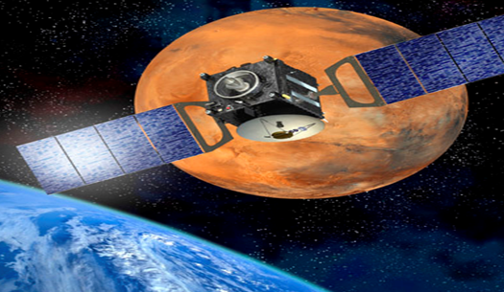
Scientists have sent spaceship to Mars. The journey has taken several months.

Slide 12
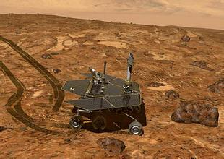
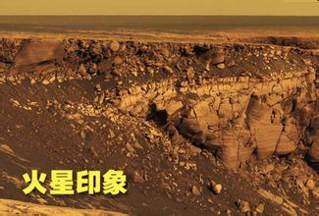
—Are there any astronauts in the
spaceship?
—No, there aren’t.

Slide 13
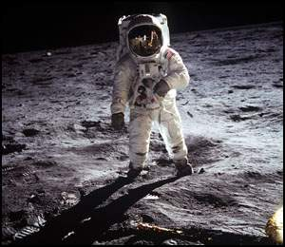
Astronauts have already been to the moon.

Slide 14
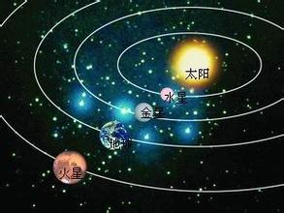
No one has been to Mars yet, because Mars is very far away, much farther than the moon.

Slide 15
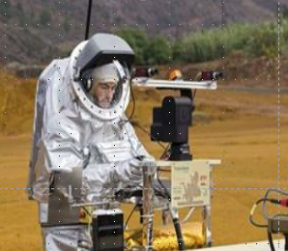
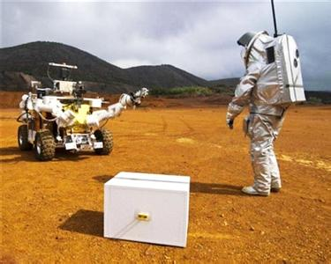
Lots of scientists are working hard in order to send astronauts to Mars one day.

Slide 16
You can go online to search for information.

Slide 17
3. Now answer the questions.
1. What school project have Daming and Tony got?
2. How does Daming feel about the school project?
They have got a project on spaceships.
He’s not sure how to make the model.

Slide 18
3. What news has Tony heard?
4. Has anyone been to Mars? Why?
The spaceship to Mars has reached there.
No one has been to Mars yet, because Mars is very far away, much farther than the moon.

Slide 19
4. Complete the passage with the correct form of the words in the box.
Arrive, discover, planet, send, yet

Slide 20
On today’s news, Tony has heard that scientists have (1) ____ a spaceship to Mars and it has (2) _______ on the (3) _____ after a journey of several months from the earth. Scientists have not (4) _________ life on Mars (5) ___. And no astronaut has ever been to Mars because it is very far away.
sent
arrived
planet
discovered
yet

Slide 21
Language points
1. What are you up to? 你在做什么呢？
up to 表示“正在干，从事着”。常用
在非正式常合中。
e.g. What’s he up to with all those books on the floor?
What were you up to yesterday? You didn’t answer my phone.

Slide 22
2. I’ve just made this model of the space station.
这是我刚做的宇宙空间站的模型。
just常用在现在完成时的肯定句中，常放在助动词have/has后面。
e.g. We’ve just watched the film.
我们刚看了电影。

Slide 23
3. I haven’t started it yet.
我还没有开始做呢。
yet表示“还（末）”，常用在现在完
成时的否定句中，通常放在句末。
e.g. We haven’t finished our homework
yet.
我们还没有完成作业。

Slide 24
4. Have you heard the latest news?
你听说过这个最新消息吗？
latest adj.最近的；最新的
e.g. The news is all about the latest
meeting. 这条消息是关于最近的会议的。

Slide 25
5. That’s why it’s on the news.
这就是它为什么出现在新闻报导的原因。
That’s why… 这就是为什么……
e.g. That’s why they didn’t like the music.
这就是为什么他们不喜欢这个音乐。
on prep. 在(播放)中；关于……
e.g. What’s on the TV?
电视正在播放什么节目？

Slide 26
6. So have they discovered life on Mars?
所以他们在火星上发现生命了吗？
discover v. 发现；找到
e.g. The fact is that he did not discover it.
事实是他没有发现它。

Slide 27
7. Astronauts have already been to the
moon. 宇航员已经去过月球了。
already表示“已经”，常放在have/ has之后，通常用于肯定句中。
e.g. Jack has already finished his homework.
have/ has been to表示曾经去过某地，但现
在已经回到他的生活所在地。
e.g. They’ve already been to Suzhou twice.
他们已经去过苏州两次了。

Slide 28
just/already/yet用法小结
just “刚刚”；
already “已经”，一般置于have/has之
后，两者都用于肯定句；
yet 用在否定句和疑问句，表示“还未”。
have been to 表示“去过某地”，但现在已
经回来了；
have gone to 表示“去了某地”，现在不在
这里（说话人所在地）。

Slide 29
Pronunciation and speaking
5. Listen and underline the words the
speaker stresses.
1. I’ve just made a model spaceship for our
school project.
2. I haven’t started yet because I’m not
sure how to make it.
3. Has it arrived yet?
4. Astronauts have already been to the moon.
Now listen again and repeat.

Slide 30
Make lists of what we have and have not done in space travel.
We have
_________________________________
_________________________________
_________________________________
_________________________________
A dog has travelled in space.
Men have travelled to the moon.
Spaceships have taken photographs on Mars.

Slide 31
We have not…
_________________________________
_________________________________
_________________________________
We have not built houses in space.
Astronauts have not been to Mercury.
Scientists have not visited Venus.

Slide 32
Work in pairs.
7. Talk about space travel with the
lists in Activity 6.
—Have we sent a spaceship to Mars?
—Yes, we have. But…

Slide 33
Exercise
1. —Where’s Ben?
—He______ to the teachers’ office.
He’ll be back soon.
A. go B. has gone
C. has been

Slide 34
2. —Will you please go to see the
movie Guanyinshan with me?
—No, I won’t. I ______ it already.
A. saw B. have seen
C. see D. will see

Slide 35
3. She isn’t at the cinema now because she _________ the library.
A. has been to B. have been to
C. have gone to D. has gone to
4. —Jim isn’t in the classroom. Where
is he?
—He _______ to the teacher’s office.
A. will go B. has gone
C. had gone D. is going

Slide 36
5. —I’d like you to tell me something
about Shen Nongjia.
—I’m sorry, but neither Jack nor
I ____ there.
A. have been B. has been
C. have gone D. has gone

Slide 37
Complete the sentences.
1. 我们已经到达上海。
We __________________ Shanghai.
2. 他刚刚做完这个模型。
He ____________ this model.
3. 这个女孩在干什么？
What ___ this girl ______?
have already reached
has just made
is up to

Slide 38
4. —你曾经去过香港吗？ —是的。
—_____ you ___________ Hong Kong?
—Yes, I _____.
5. 他们听说过这个最近的新闻吗？
Have they ___________________?
Have ever been to
have
heard this latest news

