Slide 1
四年级英语
Unit3 It's a pineapple
WWW.PPT818.COM

Slide 2
目录Contents
A story
Grammar
Exercises
Let's sing
Homework

Slide 3
Part 1
A story

Slide 4
A story
I like to play outside.
Hello,everyone.
My name is Sakura Momoko.

Slide 5
What's this？
What's that？
It's a watermelon.
It's a mango.

Slide 6
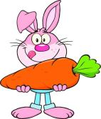
What's that？
It's an eggplant.
What's this？
It's a carrot.

Slide 7
Part 2
Grammar

Slide 8
Grammar
近
this用来指示离说话人比较近的单个人或物；
远
that用来指示离说话人比较远的单个人或物。

Slide 9
Grammar
What's this?
What's that?
This is a/an...
That is a/an...
It's a/an...

Slide 10
Part 3
Exercises

Slide 11
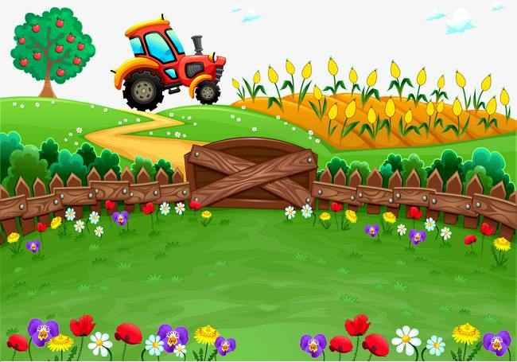
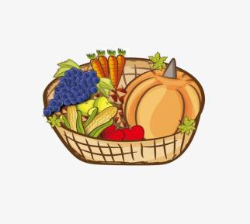
that
What's ？
that
What's ？
It's
a potato.
It's
an apple.
this
What's ？
this
What's ？
It's
a pineapple.
It's
a green pepper.

Slide 12
Part 4
Let's sing

Slide 13
Part 5
Homework

Slide 14
Homework
Try to make new dialogues by using“What's this/that”“It's a/an...”with your parents or friends.
1
2
Copy the new words

Slide 15
Thanks for watching！

